Slide 1
DIGITAL ALARM CLOCK USING NEXYS-4 ARTIX -7 FPGA BOARD
SCHOOL OF COMPUTER SCIENCE AND ENGINEERING
LOVELY PROFESSIONAL UNIVERSITY
Name: Movva Maheswara Naga Vardhan Sarma
Reg No:12009874
Roll No: RKMO48A05
Presented To: Jyotirmoy Pathak

Slide 2
AGENDA
Introduction to Nexys-4 Artix-7 FPGA Board
Block Diagram of Digital Alarm Clock
Master XDC Blocks
Modules
RTL
Simulation
Working on Digital Alarm Clock on FPGA
Power and Time Analysis

Slide 3
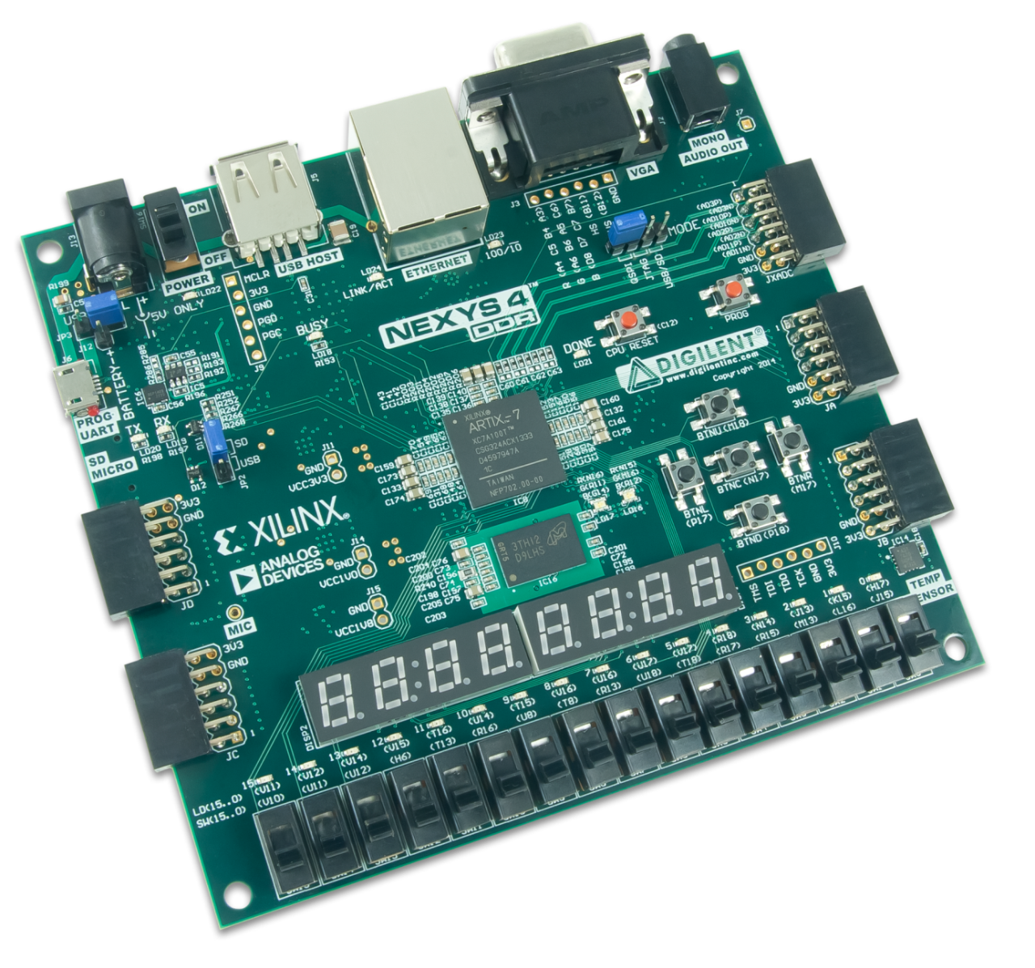
Introduction to Nexys-4 Artix-7 FPGA Board

Slide 4
Features
Xilinx Artix-7 FPGA XC7A100TCSG324-1
15,850 logic slices, each with four 6-input LUTs and 8 flip-flops
4,860 Kbits of fast block RAM
Six clock management tiles, each with phase-locked loop (PLL)
240 DSP slices
Internal clock speeds exceeding 450 MHz
On-chip analog-to-digital converter (XADC)
A 128 Mbit cellular RAM (pseudo-static DRAM)
• A 128 Mbit non-volatile serial flash device

Slide 5
Connectivity and Onboard I/O
SD: microSD card connector
Pmod Connectors: 4 Pmod ports
VGA:12-bit VGA port
Audio: PWM audio output
Temp sensor: One temperature sensor
Display: 2*4-digit seven segment displays
Switches: 16
Buttons: 4
LEDs:16
Tri-color LEDs: 2

Slide 6
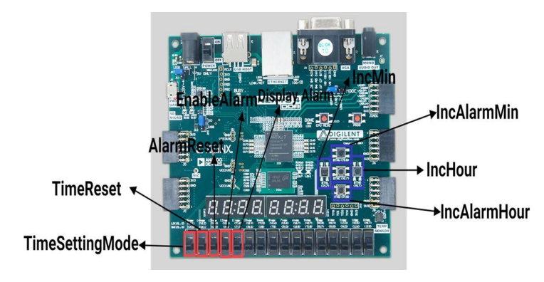
Description about the Switches and Pushbuttons

Slide 7
TimeSettingMode: If the [sw15] is high then it allows the increment operation of the Minute and Hour in the FPGA using the [Increment Minute] BTNL and [IncrementHour] BTNR using pushbuttons. If the [sw15] is low, then it is automatically under the control of the clock.
TimeReset: If the [sw14] is high then it Reset the time else does not Reset.
AlarmReset: If the [sw13] is high then it Reset the Alarm else does not Reset.
EnableAlarm: If the [sw12] is high then the comparison of time and alarm is equal to the [LED0] high.
DisplayAlarm: If the [sw11] is high then it displays the Alarm in Seven Segment Display

Slide 8
IncMin: If [BTNL] pushbutton is high and TimeSettingMode is high then it changes the Time Minute
IncHour: If [BTNR] pushbutton is high and TimeSettingMode is high then it changes the Time Hour
IncAlarmMin: If [BTNU] pushbutton is high and Display Alarm is high then it changes the Alarm Minute
IncAlarmHour: If [BTND] pushbutton is high and Display Alarm is high then it changes the Alarm Hour.

Slide 9
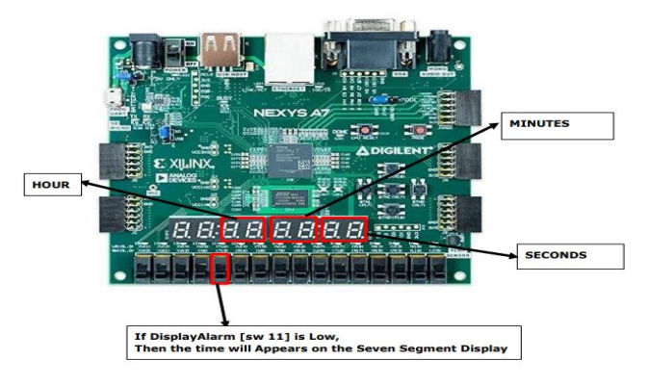
For Time

Slide 10
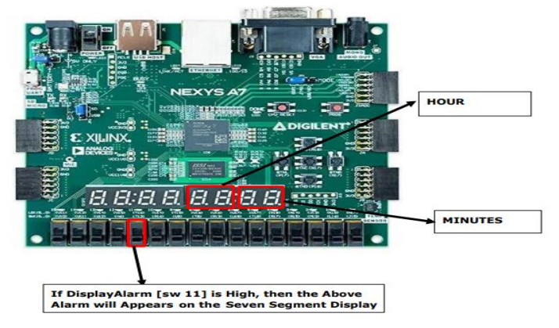
For Alarm

Slide 11
BLOCK DIAGRAM

Slide 12
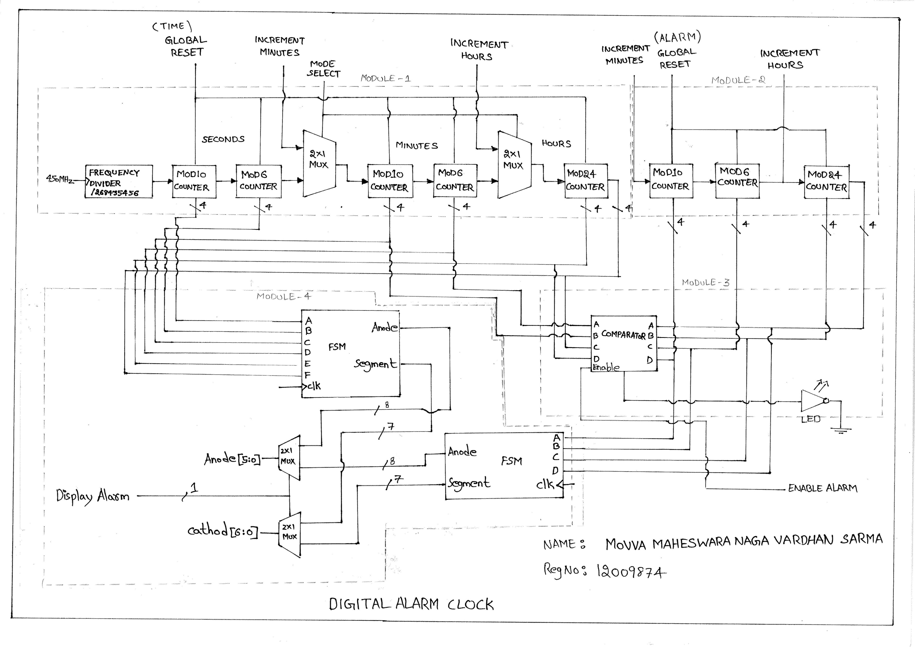

Slide 13
Working on Digital Alarm Clock on FPGA

Slide 14
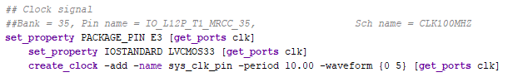
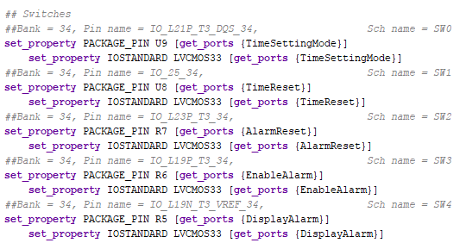
Master XDC Blocks

Slide 15
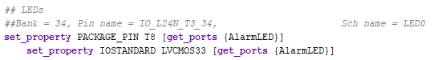
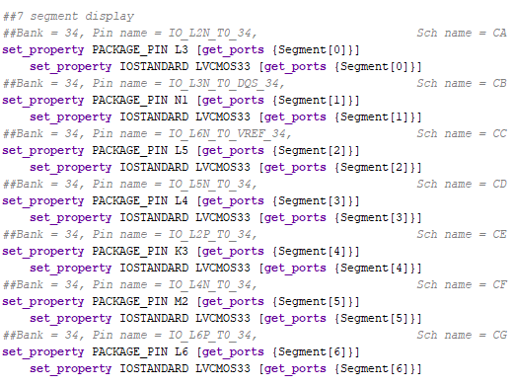

Slide 16
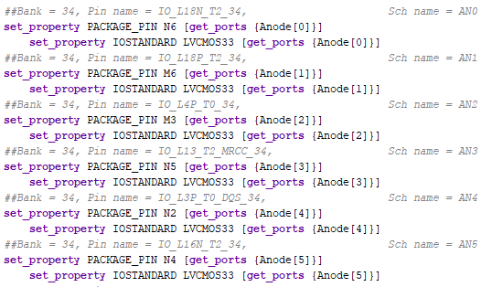
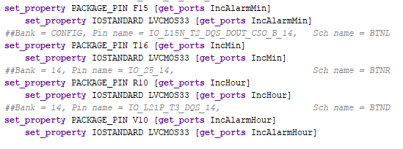

Slide 17
Modules
Time Module
Alarm Module
Comparator Module
7-Segment Display Driver Module
Debouncing Pushbutton Module

Slide 18
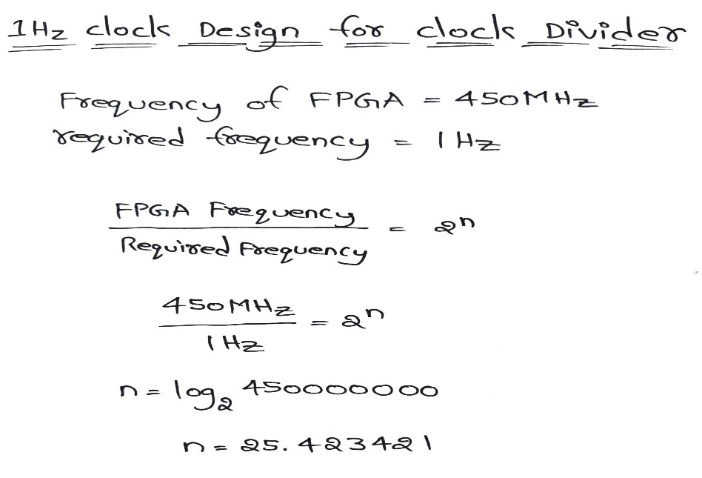
CLOCK DIVIDER CALCULATION FOR 1Hz

Slide 19
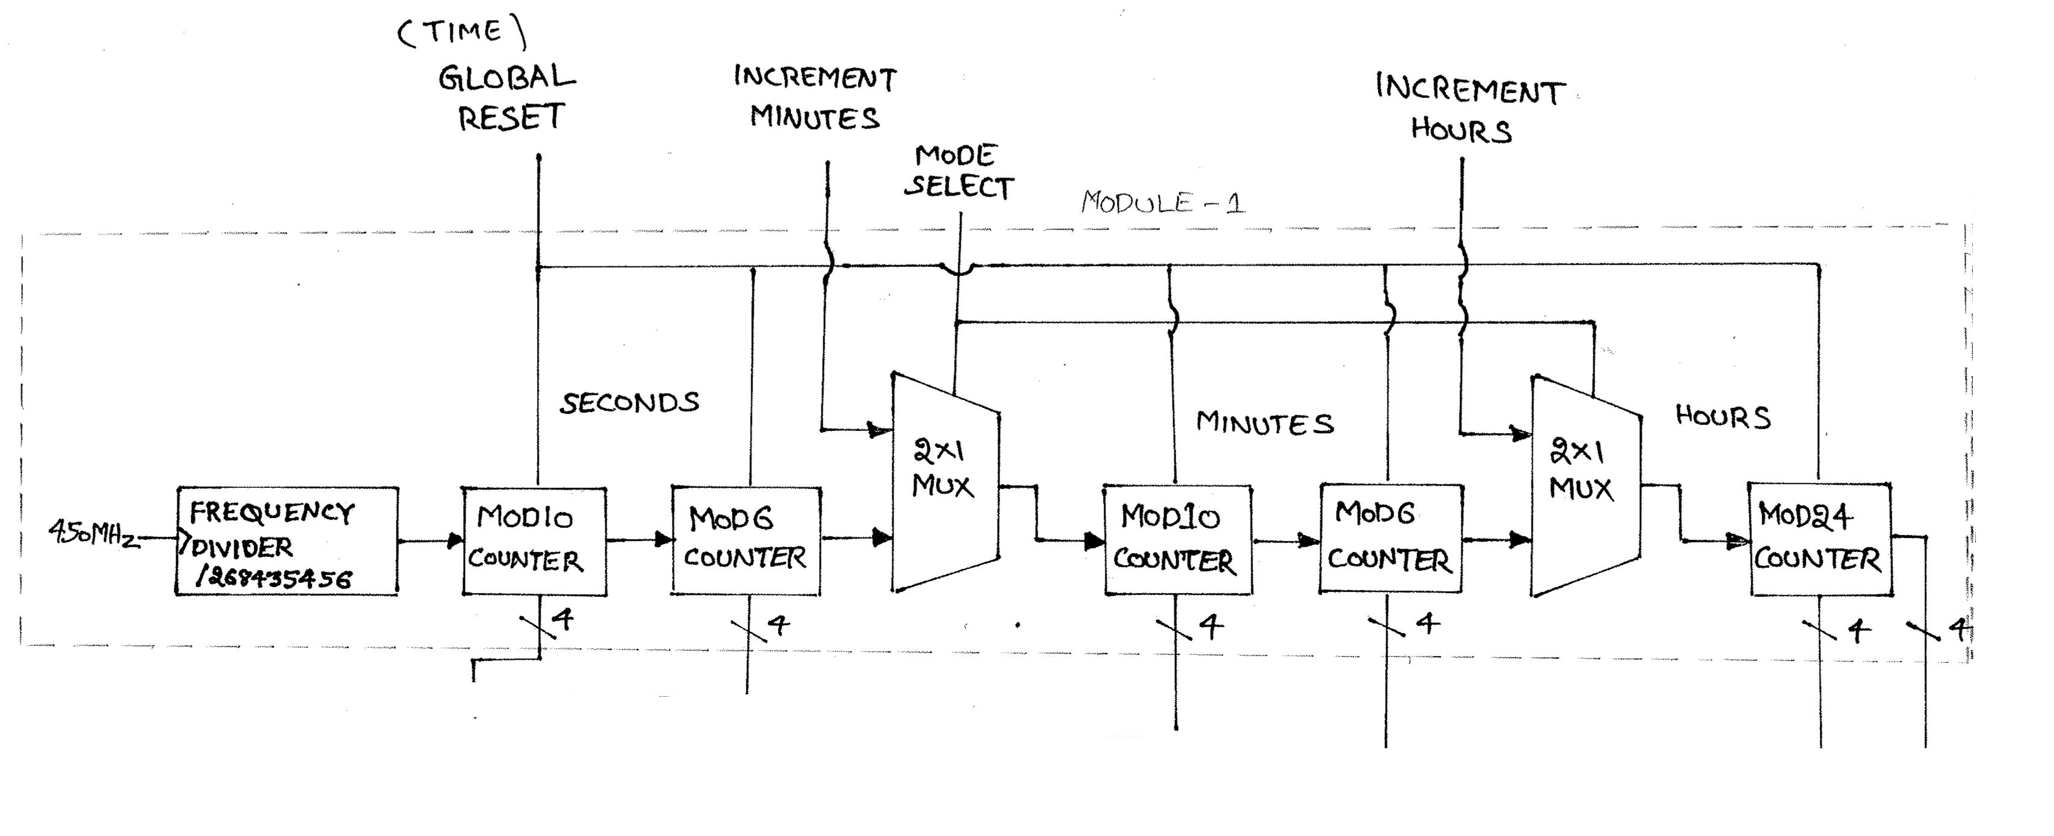
Time Module

Slide 20
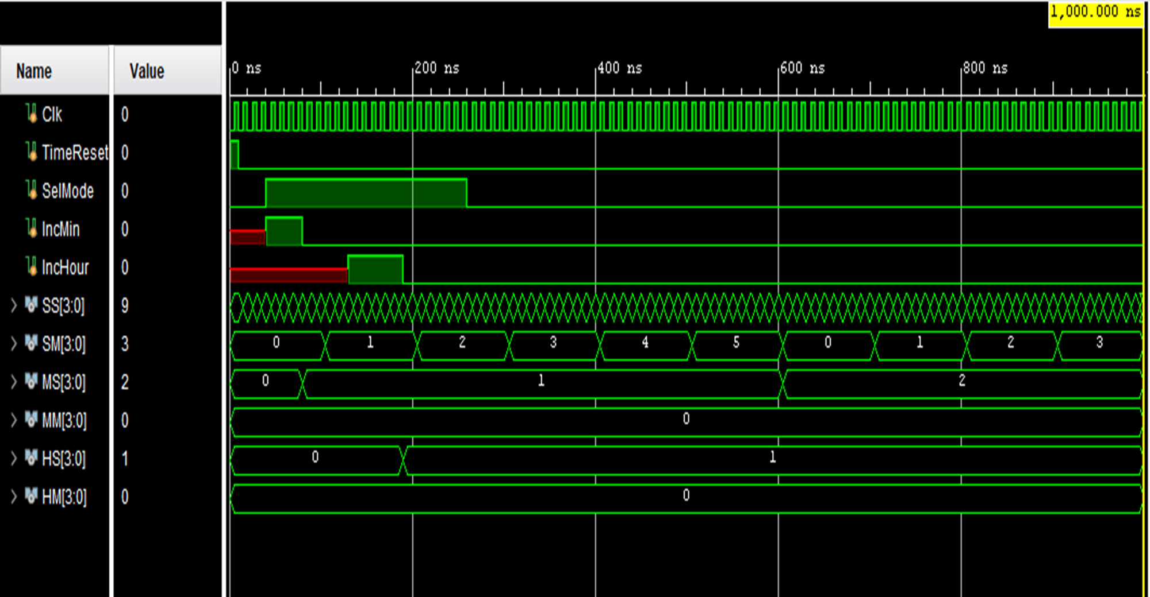

Slide 21
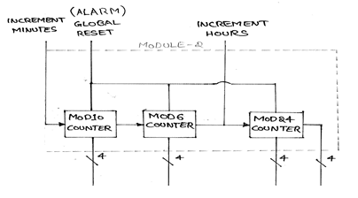
Alarm Module

Slide 22
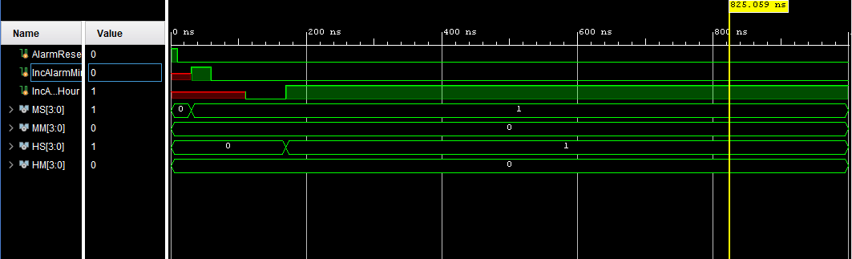

Slide 23
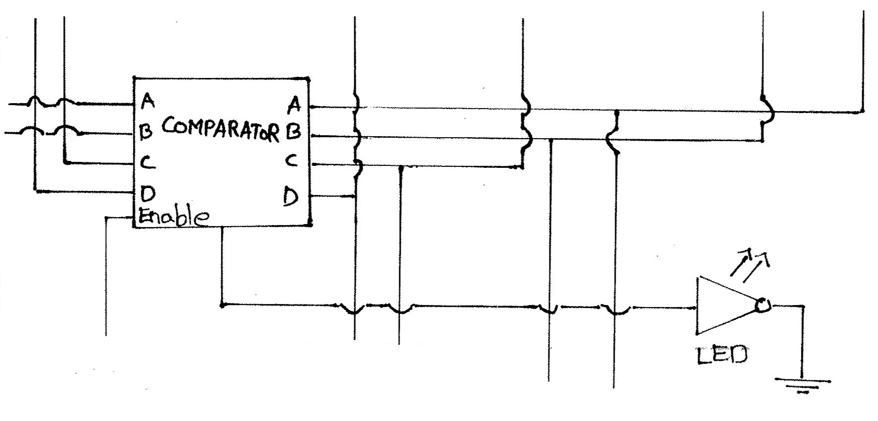
Comparator Module

Slide 24
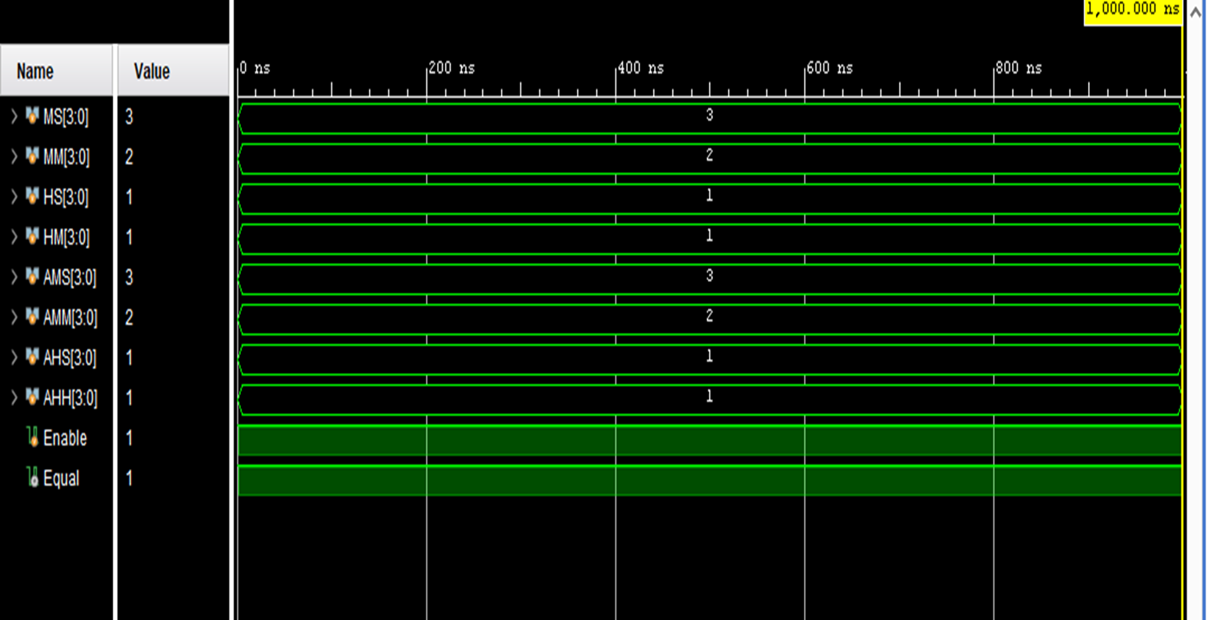

Slide 25
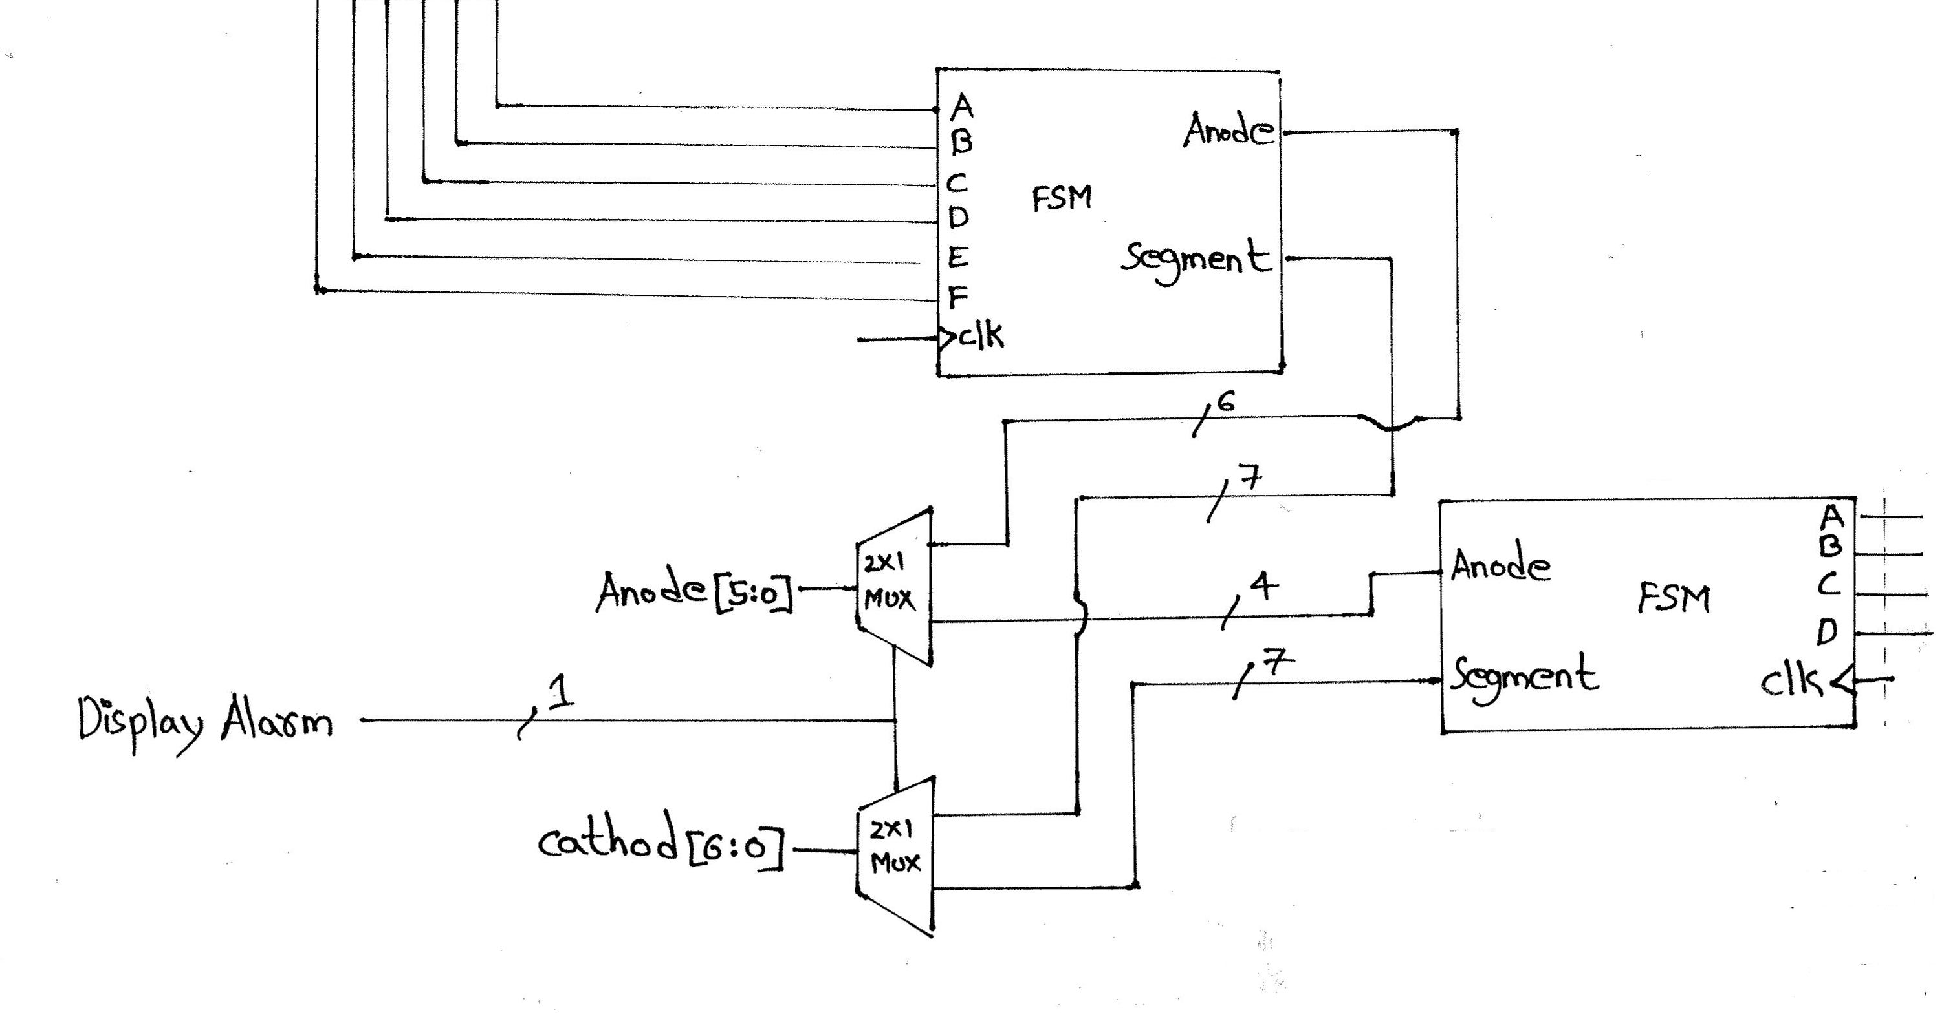
7-Segment Display Module

Slide 26
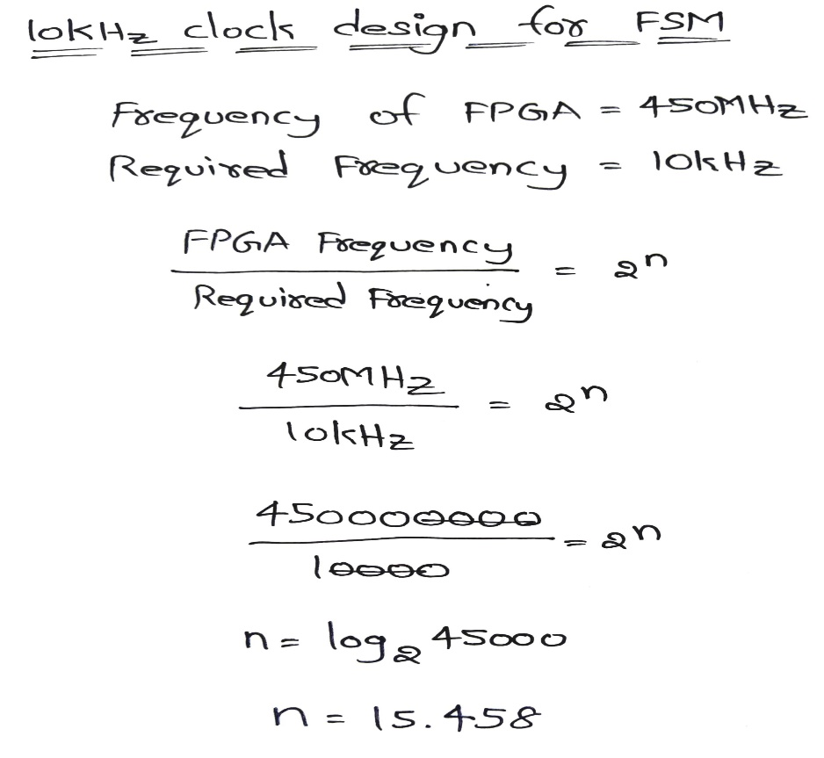
CLOCK DIVIDER FOR 10KHz

Slide 27
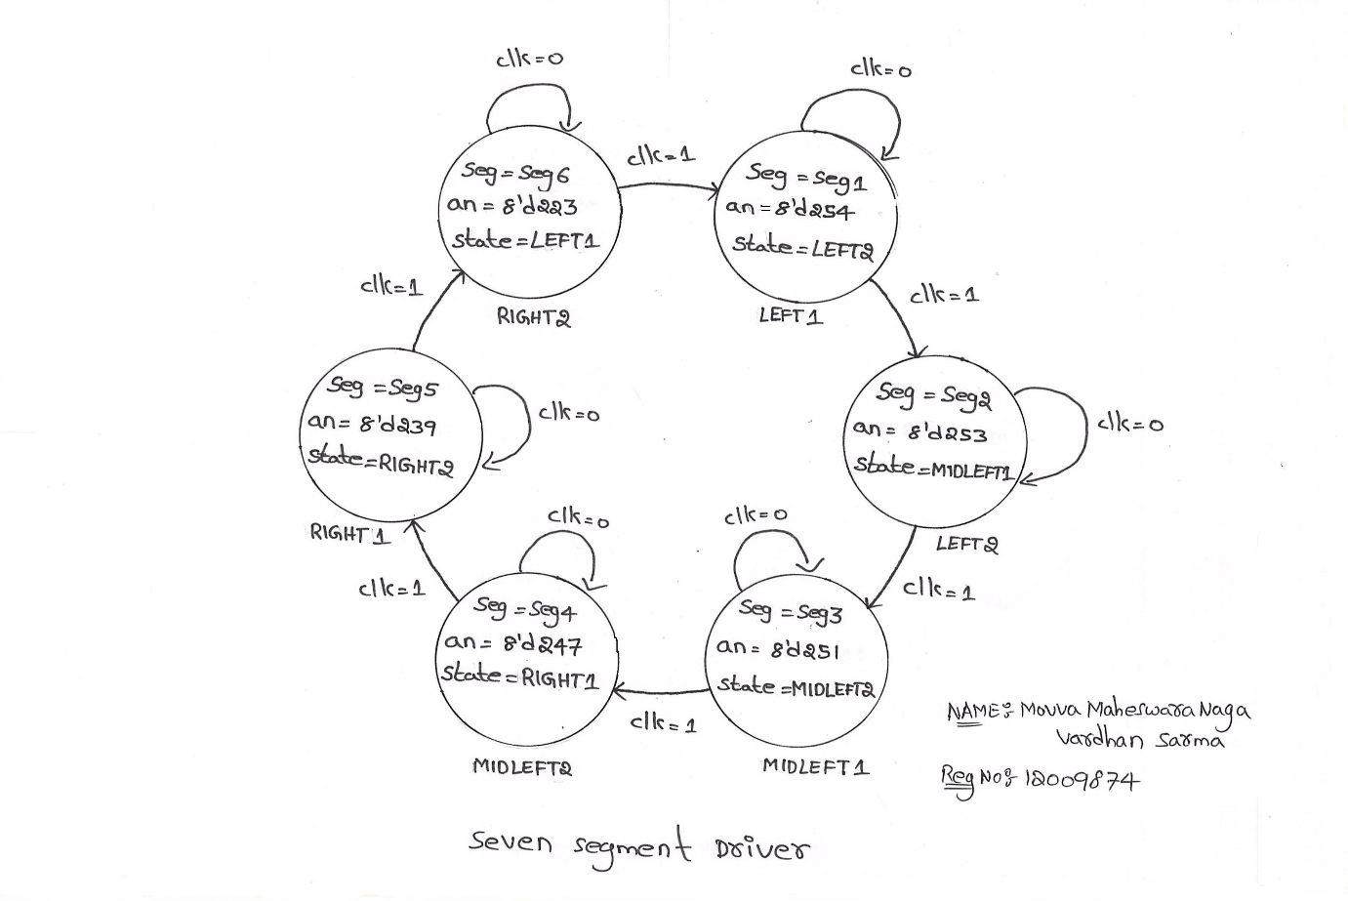
FSM SEVEN SEGMENT DISPLAY DRIVER FOR TIME MODULE

Slide 28
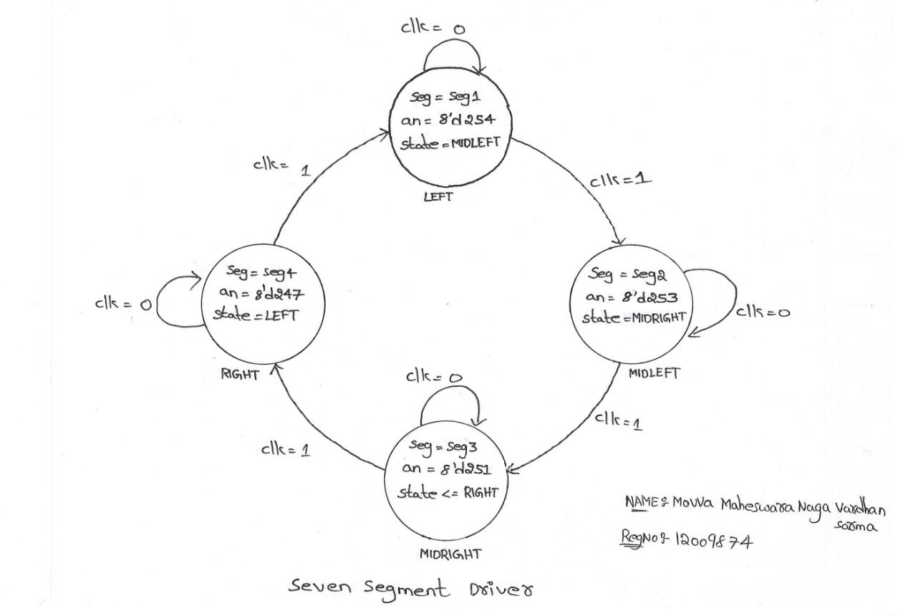
FSM SEVEN SEGMENT DISPLAY DRIVER FOR ALARM MODULE

Slide 29
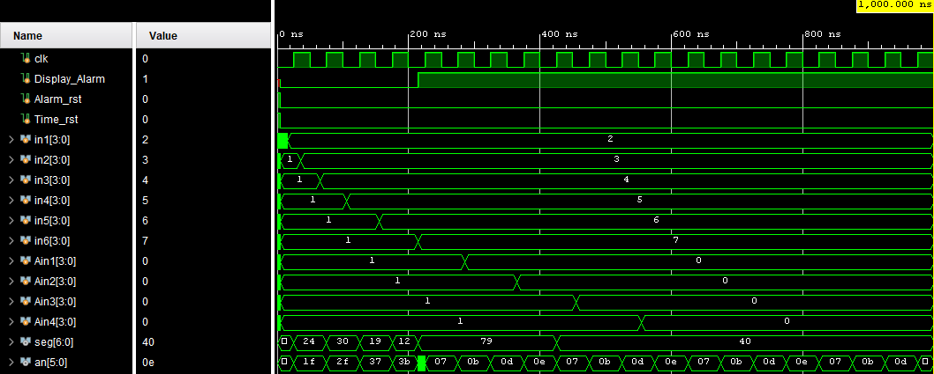

Slide 30
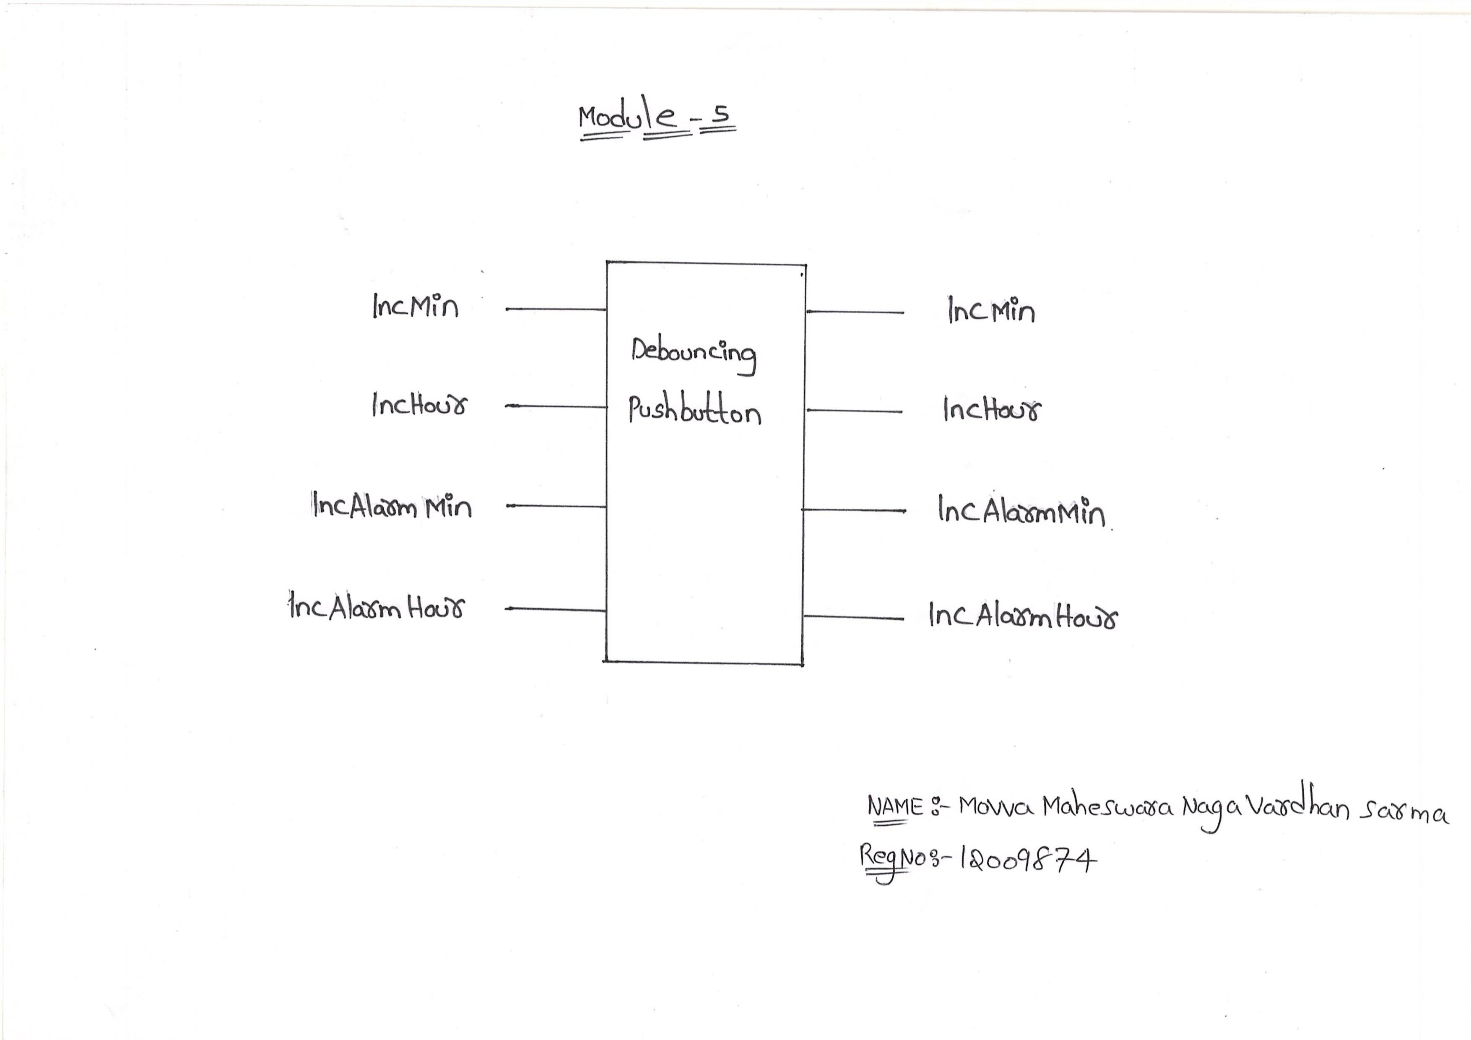
Pushbutton Debouncing

Slide 31
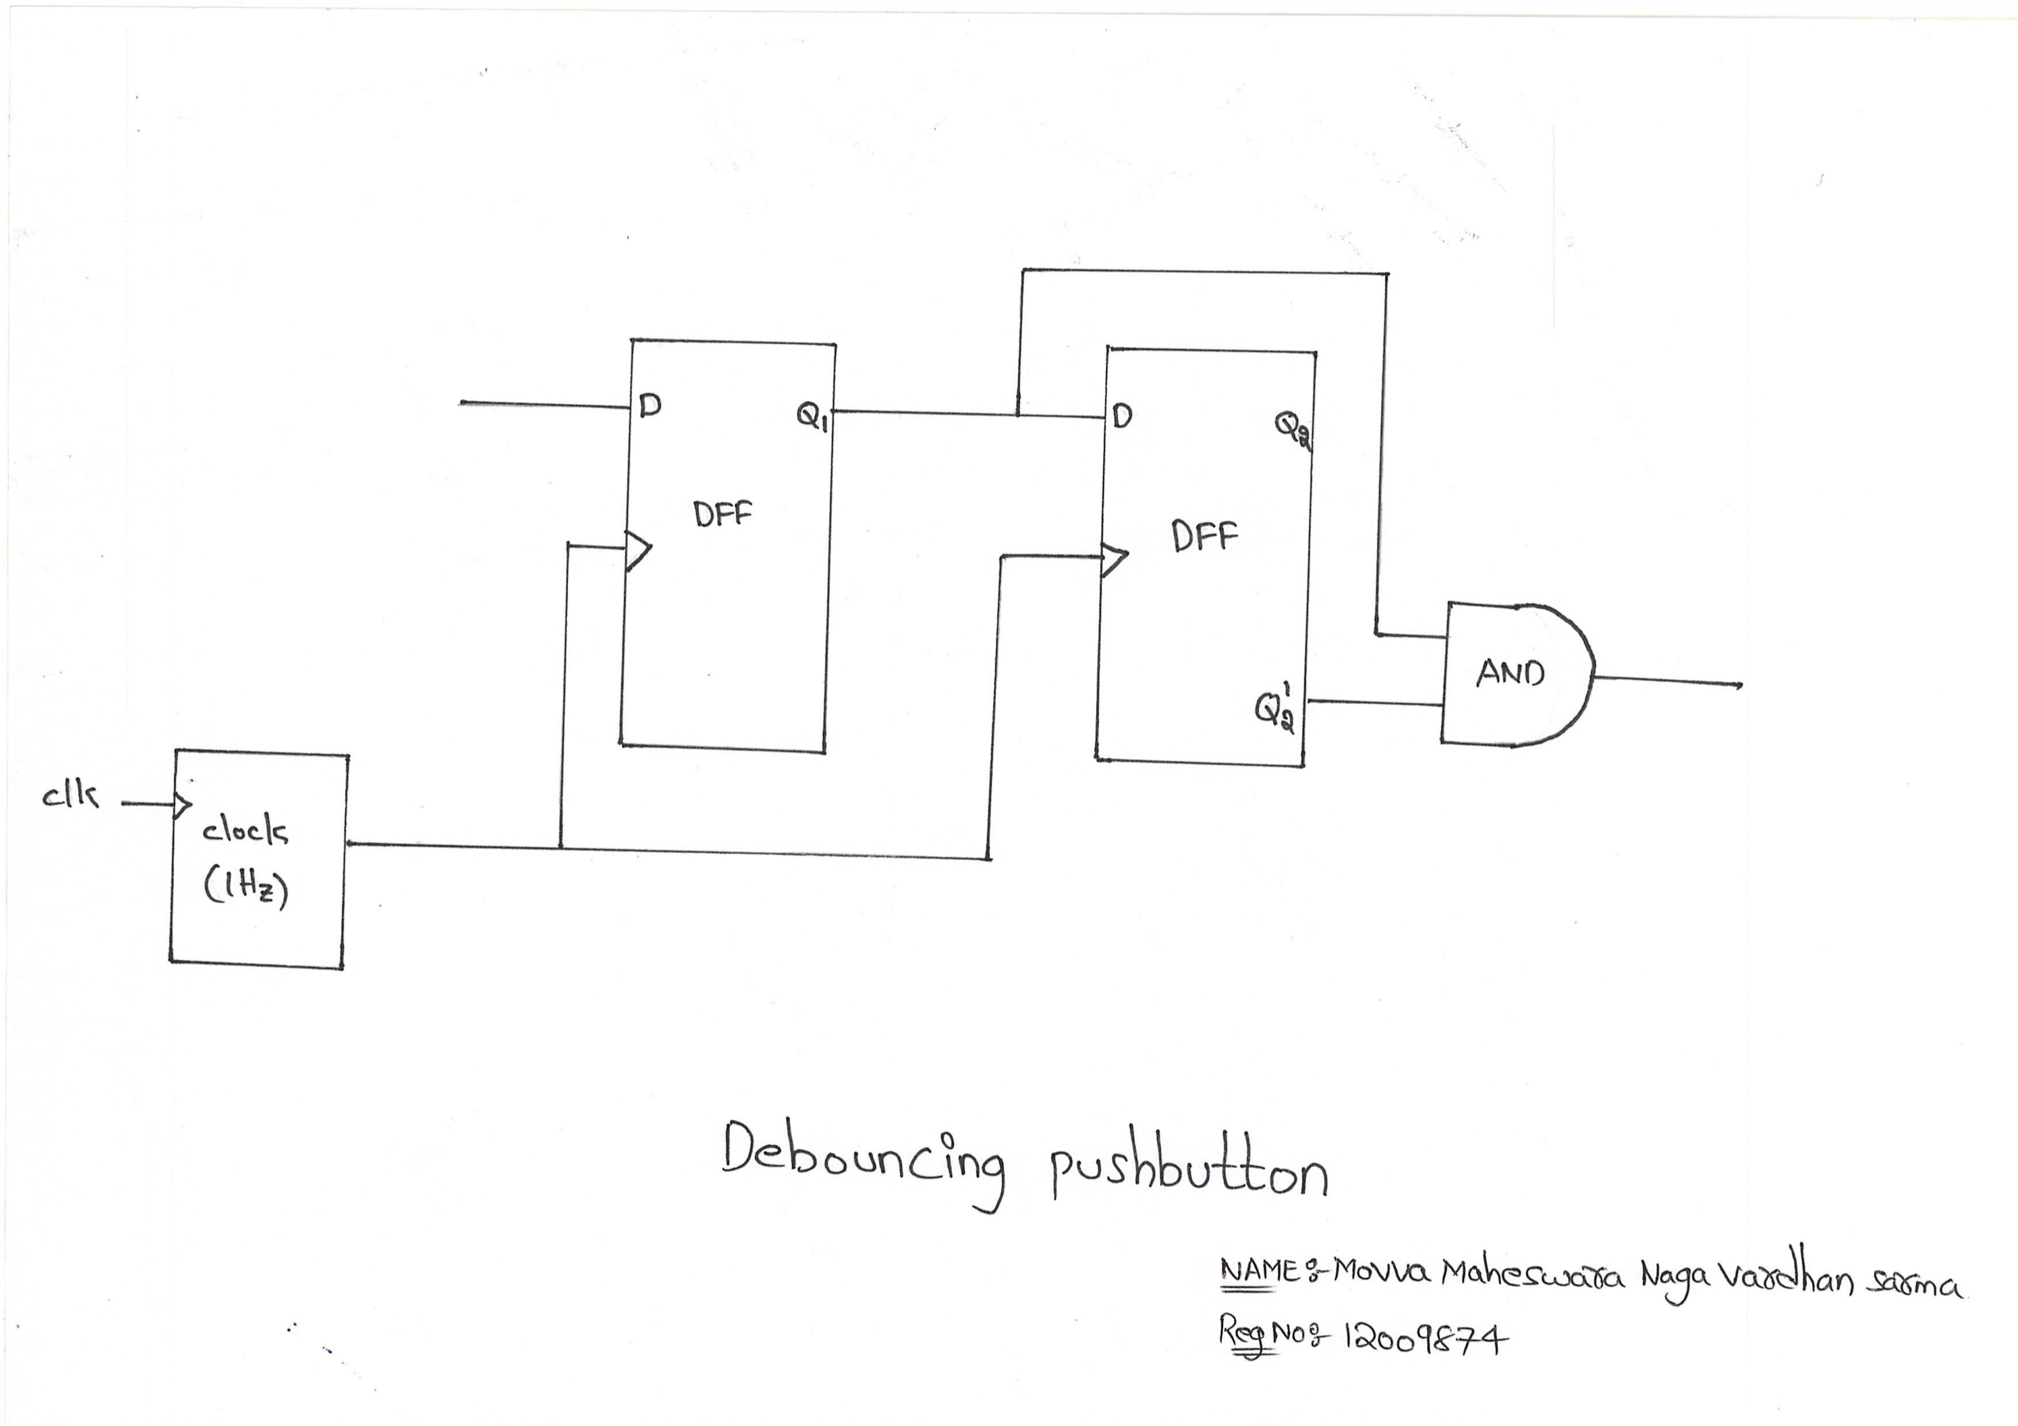
Internal Structure

Slide 32
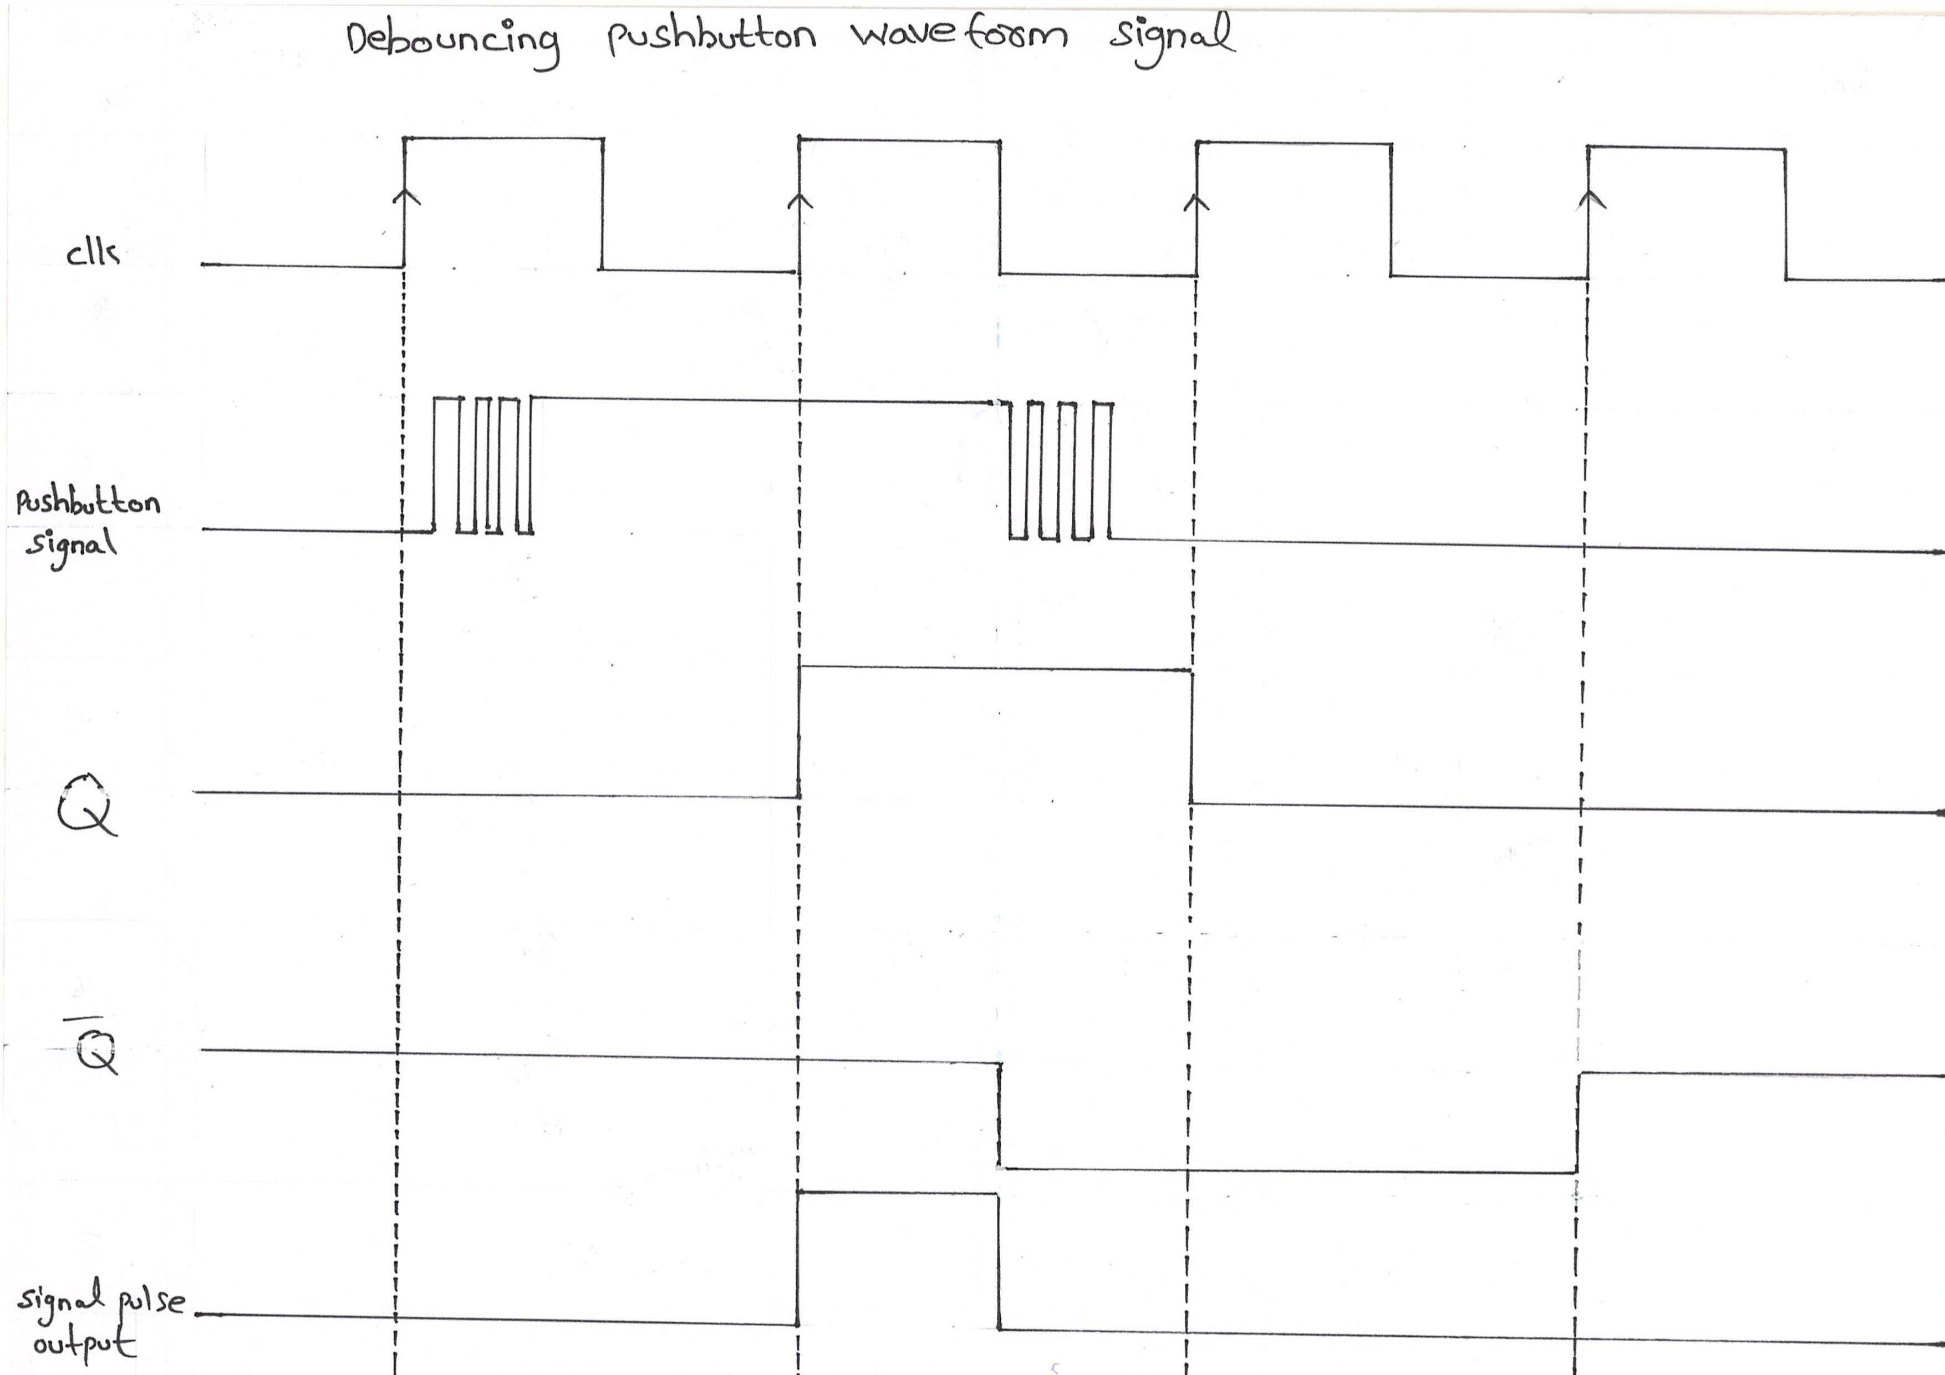
Detail Waveform

Slide 33
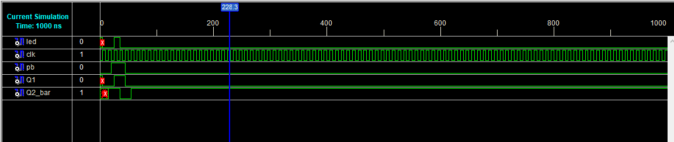

Slide 34
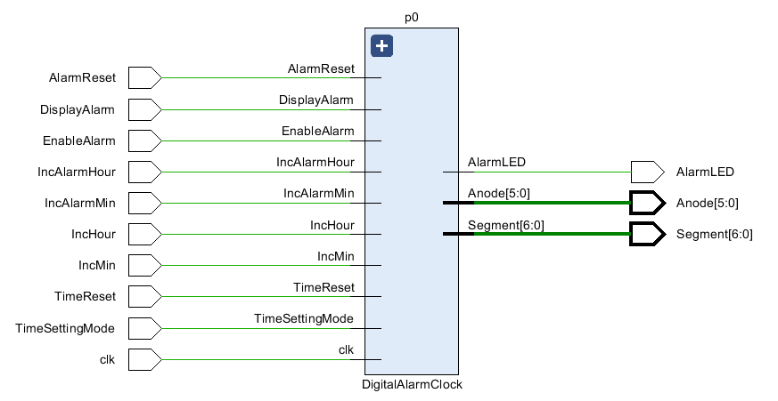
RTL

Slide 35
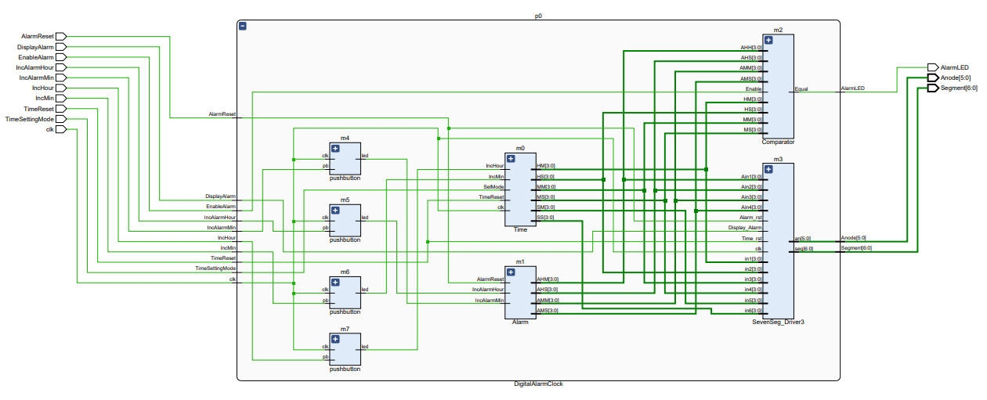
Internal View

Slide 36
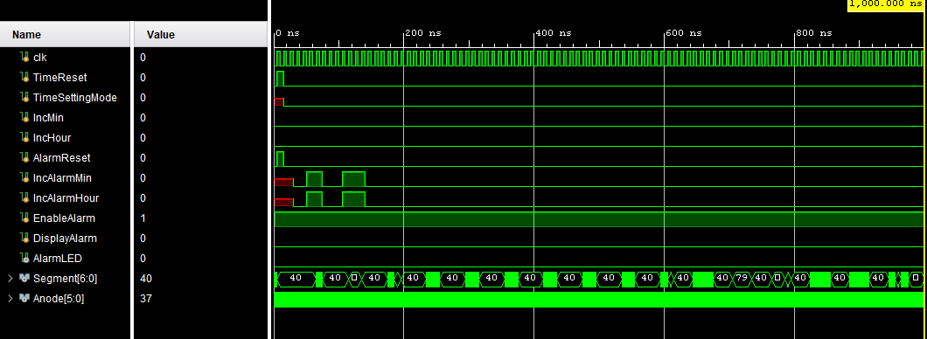
Simulation

Slide 37
Power and Time Analysis

Slide 38
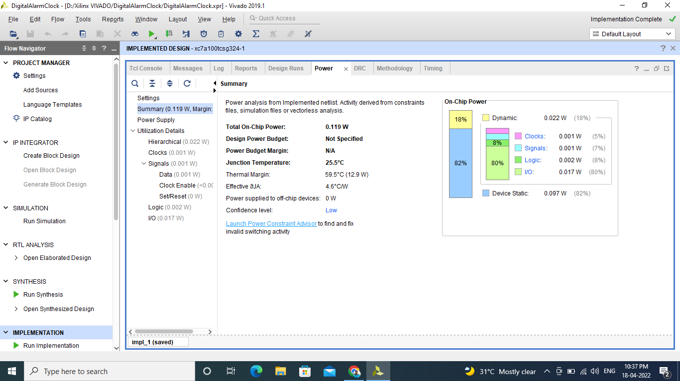
POWER ANALYSIS

Slide 39
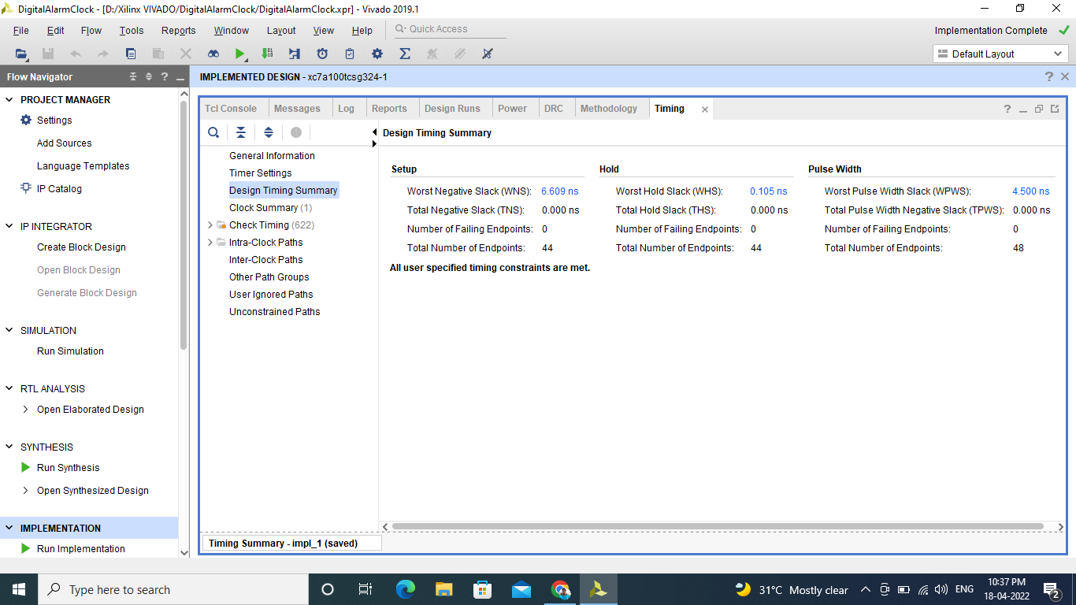
TIME ANALYSIS

Slide 40
Thank You

